Slide 1


Parts Give More Than Wholes: Paradigms from the Perspective of Corpus Data
Laura A. Janda, UiT The Arctic University of Norway
Francis M. Tyers, Higher School of Economics, Moscow

Slide 2
Paradigm Cell Filling Problem (Ackerman et al. 2009)
Native speakers of languages with complex inflectional morphology routinely recognize and produce forms that they have never encountered.
Q: How is this possible?
A: Inflectional morphology is mastered through exposure to partially overlapping subsets of paradigms.

Slide 3
Why Russian?
well-documented
large hand-annotated/corrected corpus (SynTagRus)
morphologically relatively complex
relatively large numbers of forms in paradigms
relatively numerous inflectional classes
high proportion of irregular and suppletive word forms

Slide 4
Overview: 3 Types of Evidence
1) Comparison of the Percentages of Full Paradigms Attested in Corpora
2) Corpus Distribution of Partial Subsets of Paradigms
3) Computational Experiment on Learning of Full vs. Partial Paradigms

Slide 5
1) Comparison of the Percentages of Full Paradigms Attested in Corpora
Zipfian distribution: what it means for paradigms
Corpus comparison across five languages with nominal paradigm sizes ranging from 2 to 28 forms

Slide 6
Zipf’s (1949) law
Word frequency is inversely proportional to frequency rank.
Zipfian distribution:
Few words of high frequency
Sharp decline
Hapaxes accounting for ~50% of unique lexemes

Slide 7
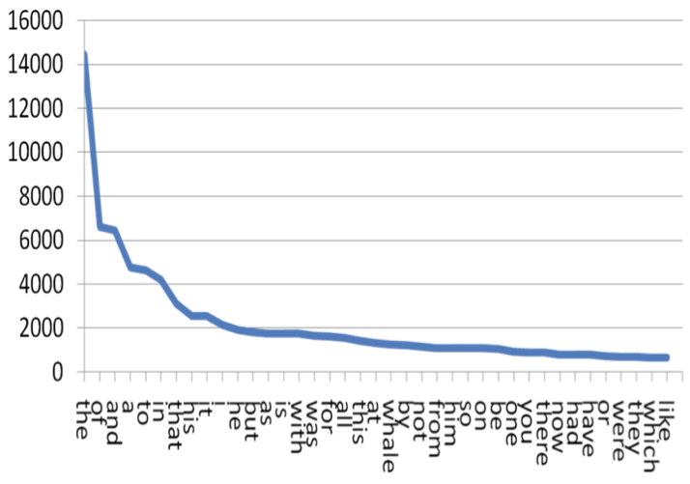
Zipf’s Law
Тhe frequency of a word is inversely proportional to its frequency rank
50% or more of all unique words are hapaxes
Zipf’s Law scales up infinitely

Slide 8
Zipf’s Law applies to word forms too
Language & Corpus Name | Corpus Size | Paradigm Size | Total Lexemes | Lexemes with full Paradigm | % Lexemes with full Paradigm
English Web Treebank | 254,830 | 2 | 6,369 | 1,524 | 23.92%
Norwegian Dependency Treebank | 311,277 | 4 | 12,587 | 393 | 3.12%
Russian SynTagRus | 1,032,644 | 12 | 21,945 | 13 | 0.06%
Czech Prague Dependency Treebank | 1,509,242 | 14 | 17,904 | 3 | 0.02%
Estonian ArborEst | 234,351 | 28 | 14,075 | 0 | 0%

Slide 9
Zipf’s Law applies to word forms too
Language & Corpus Name | Corpus Size | Paradigm Size | Total Lexemes | Lexemes with full Paradigm | % Lexemes with full Paradigm
English Web Treebank | 254,830 | 2 | 6,369 | 1,524 | 23.92%
Norwegian Dependency Treebank | 311,277 | 4 | 12,587 | 393 | 3.12%
Russian SynTagRus | 1,032,644 | 12 | 21,945 | 13 | 0.06%
Czech Prague Dependency Treebank | 1,509,242 | 14 | 17,904 | 3 | 0.02%
Estonian ArborEst | 234,351 | 28 | 14,075 | 0 | 0%
Because Zipf’s Law scales up, these numbers will never change substantially, no matter how large the corpus is

Slide 10
2) Corpus Distribution of Partial Subsets of Paradigms
Sample of wordforms of 982 lexemes
All lexemes with frequency ≥ 50 in SynTagRus representing five paradigm types:
masculine inanimate (312 lexemes)
masculine animate (95 lexemes)
neuter inanimate (238 lexemes)
feminine inanimate II (ending in -a/-я, 261 lexemes)
feminine inanimate III (ending in -ь, 75 lexemes)

Slide 11
High-frequency Russian Nouns
‘fear’ ‘soldier’ ‘department’ ‘concept’ ‘memory’
Nsg | страх | солдат | отделение | концепция | память
Gsg | страха | солдата | отделения | концепции | памяти
Dsg | страху | солдату | отделению | концепции | памяти
Asg | страх | солдата | отделение | концепцию | память
Isg | страхом | солдатом | отделением | концепцией | памятью
Lsg | страхе |  | отделении | концепции | памяти
Npl | страхи | солдаты | отделения
Gpl | страхов | солдат | отделений | концепций
Dpl |  | солдатам
Apl | страхи | солдат | отделения | концепции
Ipl | страхами |  | отделениями | концепциями
Lpl | страхах | солдатах | отделениях
Key: bold >20%, plain >10%, grey 1-9%, (blank) unattested

Slide 12
More High-Frequency Russian Nouns
‘background’ ‘champion’ ‘extent’ ‘frame’ ‘difficulty’
Nsg | фон | чемпион |  |  | трудность
Gsg | фона | чемпиона |  |  | трудности
Dsg |  | чемпиону |  |  | трудности
Asg |  | чемпионa |  |  | трудность
Isg |  | чемпионом |  |  | трудностью
Lsg | фоне |  | протяжении
Npl |  | чемпионы |  | рамки | трудности
Gpl |  | чемпионов |  | рамок | трудностей
Dpl |  | чемпионам
Apl |  | чемпионов |  | рамки | трудности
Ipl |  | чемпионами |  | рамками | трудностями
Lpl |  |  |  | рамках | трудностях
Key: bold >20%, plain >10%, grey 1-9%, (blank) unattested

Slide 13
Masculine animates

Slide 14
Typically a lexeme is found in only 1-3 wordforms
Masculine animates

Slide 15
Typically a lexeme is found in only 1-3 wordforms
The typical wordforms
are motivated by constructions
Masculine animates

Slide 16
NomPl аналитики отмечают
‘analysts make the point that’
Typically a lexeme is found in only 1-3 wordforms
The typical wordforms
are motivated by constructions
InsSg стать/быть чемпионом
‘become/be the champion’
Masculine animates

Slide 18
Any single lexeme gives exposure to only a subset of the paradigm.
Each lexeme has a different subset of most typical forms.
Collectively they populate the entire “space” of case/number combinations.
Masculine animates

Slide 19
High frequency nouns in Czech show the same pattern

Slide 20
LocPl volba ‘election’, podmínka ‘condition’, země ‘country’
GenPl koruna ‘crown’, dolar ‘dollar’, milión ‘million’, procento ‘percent’
LocSg případ ‘case’, základ ‘foundation’, doba ‘time period’, oblast ‘region’, kolo ‘bicycle’, trh ‘market’
High frequency nouns in Czech show the same pattern
DatPl občan ‘citizen’, podnikatel ‘businessman’, dítě ‘child’

Slide 21
3) Computational Experiment on Learning of Full vs. Partial Paradigms
Based on an ordered list of the most frequent forms for nouns, verbs, and adjectives in SynTagRus
Machine learning:
Given the 100 most frequent forms, predict the next 100 most frequent forms
Given the 200 most frequent forms, predict the next 100 most frequent forms
Given the 300 most frequent forms, predict the next 100 most frequent forms
Given the 400 most frequent forms, predict the next 100 most frequent forms
Given the 500 most frequent forms, predict the next 100 most frequent forms
… until 5400, when SynTagRus runs out of data

Slide 22
Computational experiment: nouns, verbs, adjectives
This is the training data
Based on an ordered list of the most frequent forms in SynTagRus
Machine learning:
Given the 100 most frequent forms, predict the next 100 most frequent forms
Given the 200 most frequent forms, predict the next 100 most frequent forms
Given the 300 most frequent forms, predict the next 100 most frequent forms
Given the 400 most frequent forms, predict the next 100 most frequent forms
Given the 500 most frequent forms, predict the next 100 most frequent forms
… until 5400, when SynTagRus runs out of data

Slide 23
Computational experiment: nouns, verbs, adjectives
This is the testing data
Based on an ordered list of the most frequent forms in SynTagRus
Machine learning:
Given the 100 most frequent forms, predict the next 100 most frequent forms
Given the 200 most frequent forms, predict the next 100 most frequent forms
Given the 300 most frequent forms, predict the next 100 most frequent forms
Given the 400 most frequent forms, predict the next 100 most frequent forms
Given the 500 most frequent forms, predict the next 100 most frequent forms
… until 5400, when SynTagRus runs out of data

Slide 24
Data for training and testing from SynTagRus
Frequency & Form | Lemma | POS | Parse of form
1447 может | мочь | VERB | Aspect=Imp|Mood=Ind|Number=Sing|Person=3|Tense=Pres|VerbForm=Fin|Voice=Act
1286 года | год | NOUN | Animacy=Inan|Case=Gen|Gender=Masc|Number=Sing
999 лет | год | NOUN | Animacy=Inan|Case=Gen|Gender=Masc|Number=Plur
832 году | год | NOUN | Animacy=Inan|Case=Loc|Gender=Masc|Number=Sing
813 время | время | NOUN | Animacy=Inan|Case=Acc|Gender=Neut|Number=Sing
678 россии | россия | NOUN | Animacy=Inan|Case=Gen|Gender=Fem|Number=Sing
571 могут | мочь | VERB | Aspect=Imp|Mood=Ind|Number=Plur|Person=3|Tense=Pres|VerbForm=Fin|Voice=Act
571 люди | человек | NOUN | Animacy=Anim|Case=Nom|Gender=Masc|Number=Plur
543 россии | россия | NOUN | Animacy=Inan|Case=Loc|Gender=Fem|Number=Sing
436 является | являться | VERB | Aspect=Imp|Mood=Ind|Number=Sing|Person=3|Tense=Pres|VerbForm=Fin|Voice=Act
416 случае | случай | NOUN | Animacy=Inan|Case=Loc|Gender=Masc|Number=Sing
411 людей | человек | NOUN | Animacy=Anim|Case=Gen|Gender=Masc|Number=Plur
403 страны | страна | NOUN | Animacy=Inan|Case=Gen|Gender=Fem|Number=Sing
400 жизни | жизнь | NOUN | Animacy=Inan|Case=Gen|Gender=Fem|Number=Sing

Slide 25
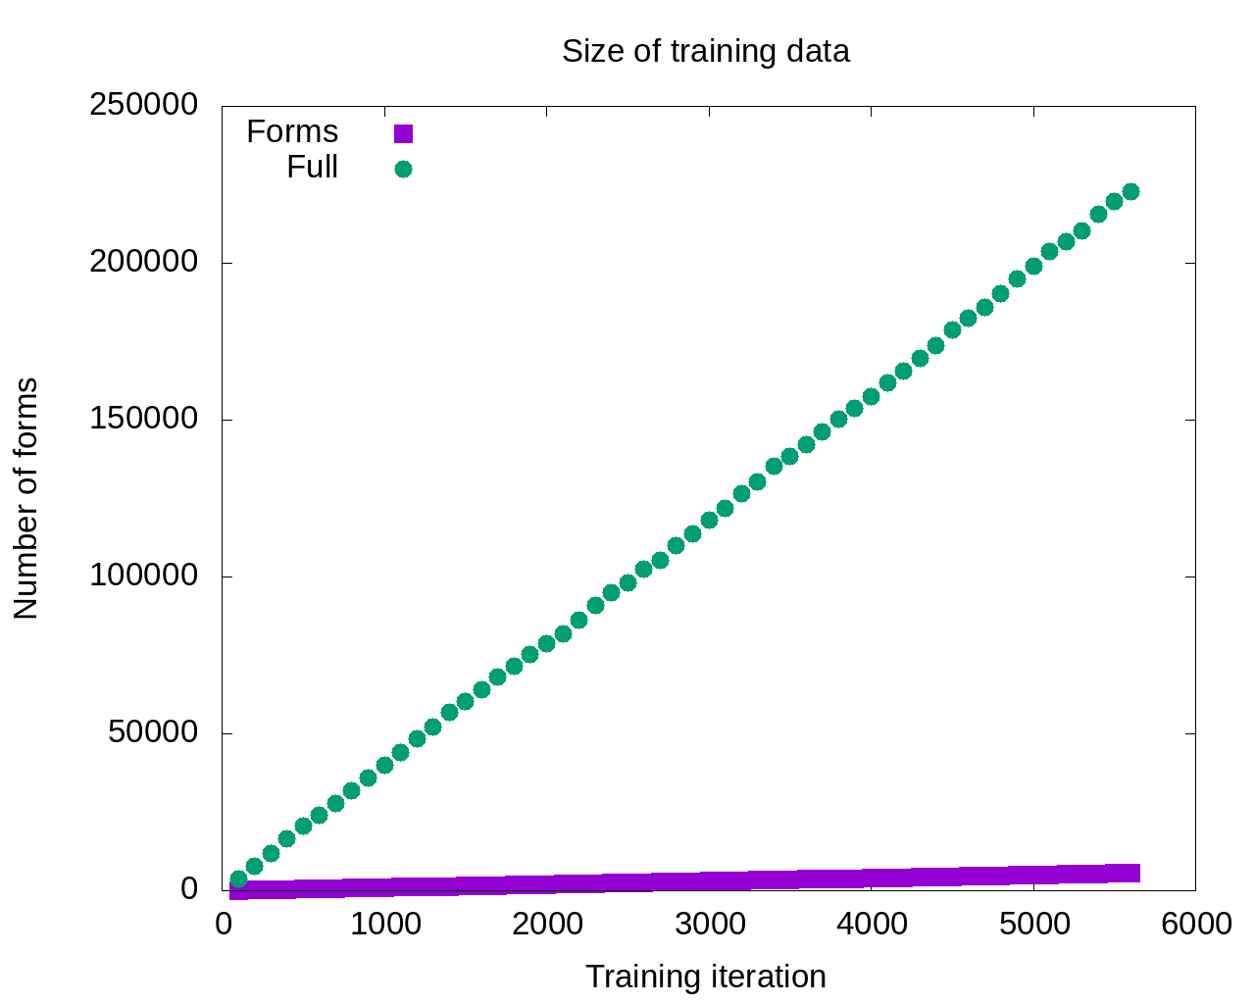

Slide 26
So the model that gets the most input should be the most successful, right?

Slide 27

Maybe not…
So the model that gets the most input should be the most successful, right?

Slide 28
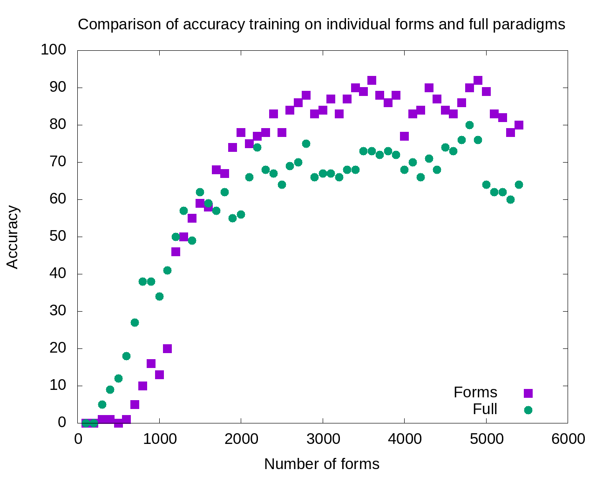

Slide 29
1800-5400:
Single forms model outperforms
full paradigms

Slide 30
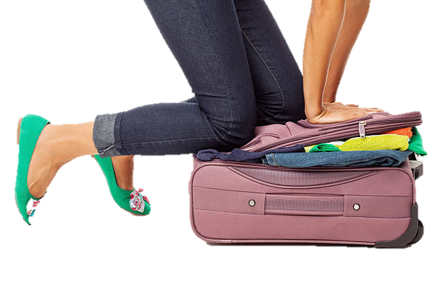
Excess data is probably overpopulating the search domain

Slide 31
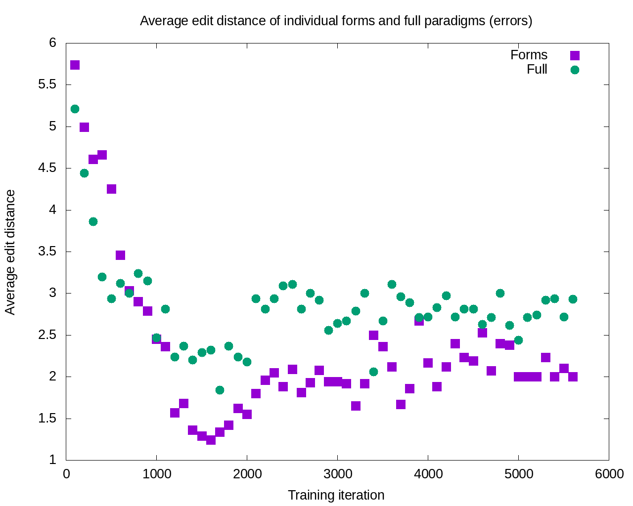

Slide 32
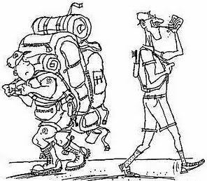
After 11 iterations, the errors committed by the single forms model are consistently smaller

Slide 33
What this means
A given word typically appears in only a handful of forms
Those word forms are motivated by constructions and collocations most typical for the word
Learning is potentially enhanced by focus only on the most typical word forms attested for given lexemes: accuracy increases and severity of errors decreases

Slide 34
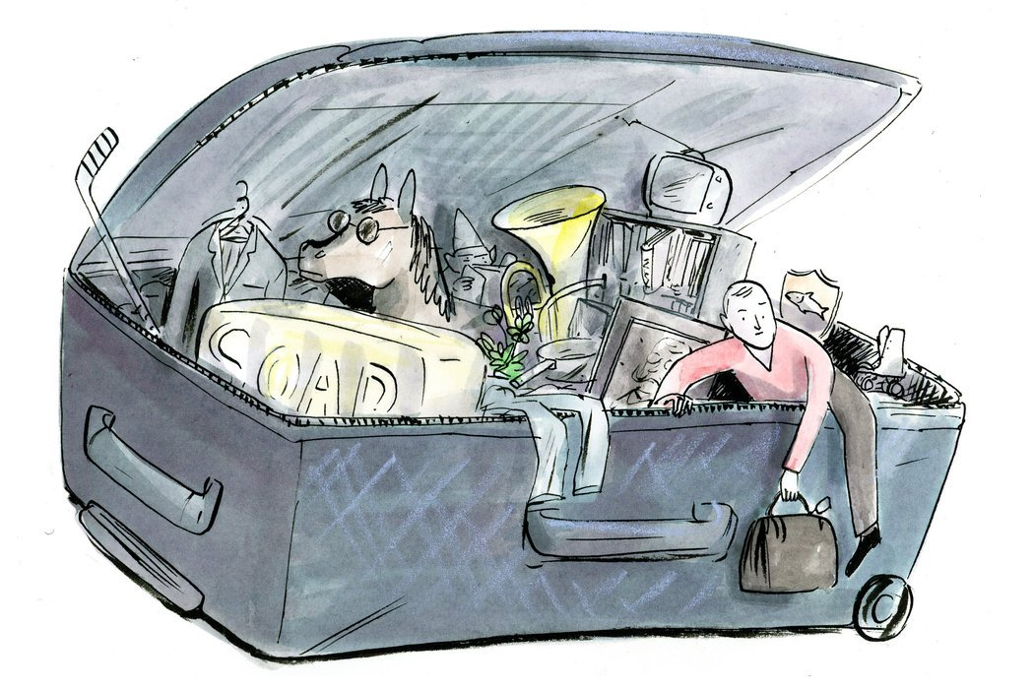
So how can we escape from this overstuffed suitcase?
Textbooks have always focused on certain forms and constructions
Now we can do this in a scientific, consistent way

Slide 35

Introducing the SMARTool
Strategic Mastery of Russian Tool
(funded by Senter for Internasjonalisering av Utdanning)
The user can browse over 3000 Russian words according to proficiency level, topic, textbook, and grammatical categories.
For each word, the SMARTool provides the three most common forms, plus example sentences that show typical collocations and grammatical constructions.

Slide 36
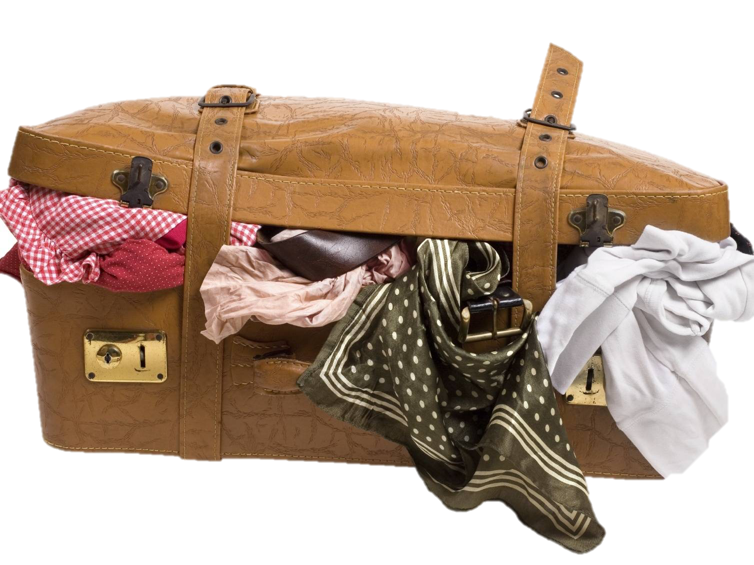
Evidence for strategically focusing learning on key forms and constructions (instead of full paradigms)
Russian and the relationship between paradigm size and number of full paradigms for nouns
There are 1-3 word forms that account for most of the frequency of any word
Those 1-3 word forms are motivated by typical grammatical constructions and collocations
In aggregate, partially overlapping subsets of forms populate the space of the paradigm
Computational experiment comparing training on full paradigms vs. single forms
Memorizing full paradigms for all words is like overstuffing your suitcase

